Slide 1
Great Gardens in the
Summer Heat
Penny Nester
Agriculture & Natural Resources Agent
Bowman County

Slide 2
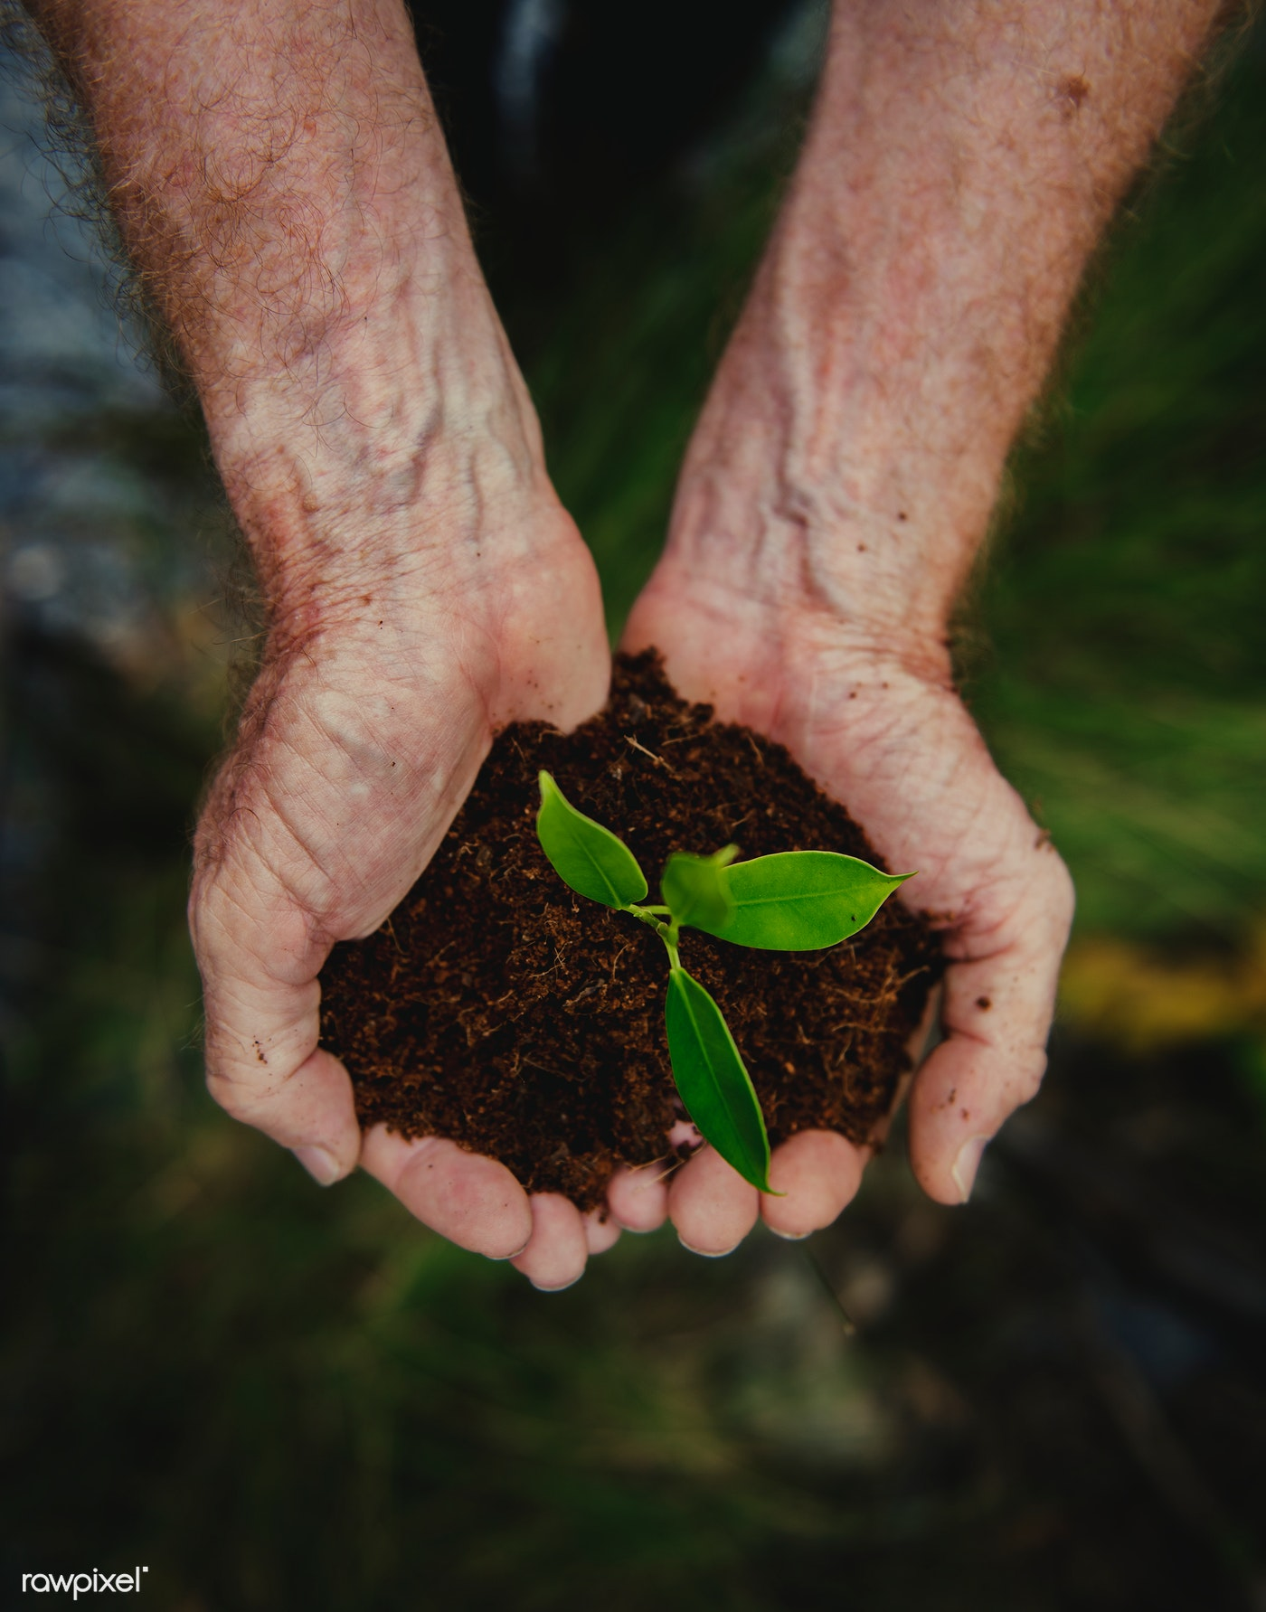
Soil
Soil test every 2-3 years before you fertilize
Add organic matter to aid in moisture retention
Watch areas of your yard to identify different landscape changes
Dry conditions help ID areas that need changes

Slide 3
Mulching
The key to retaining moisture, preventing weeds, reducing erosion & regulating soil temperature
  Organic vs Inorganic Mulches
    Organic
      Improves organic matter and increases aeration in heavy clay soil
      Keeps soil cool in the summer
    Inorganic
      More maintenance free and longer lasting
      Temperature Control
Fabric Coverings – Needs full contact with the soil

Slide 4
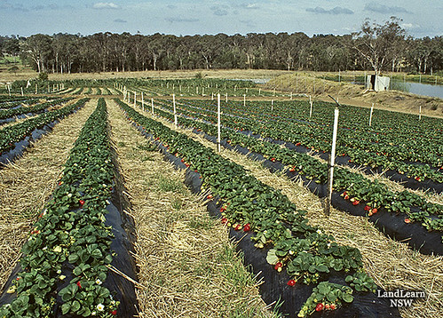
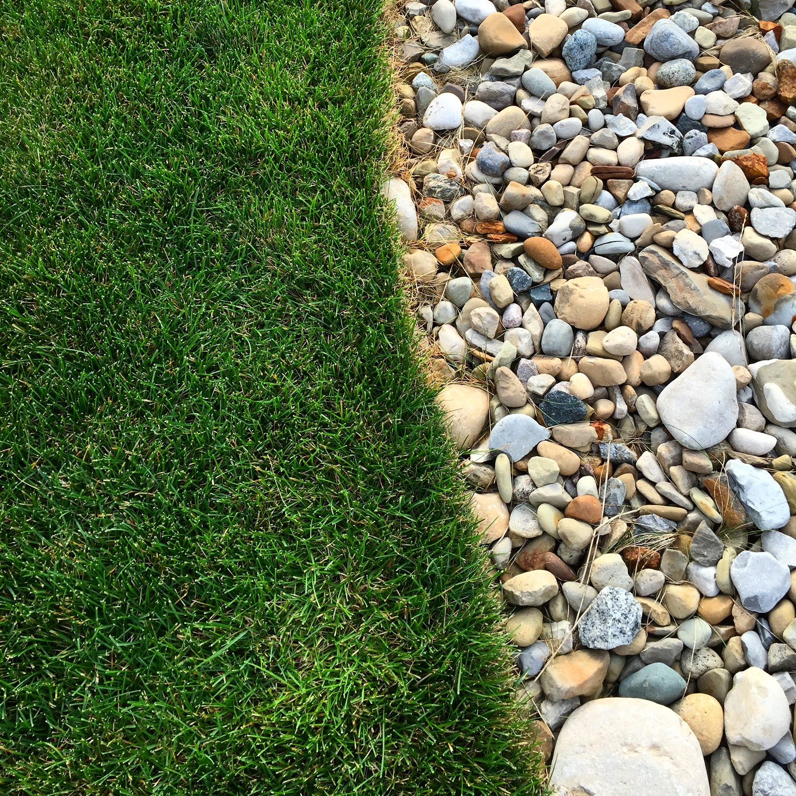

Slide 5
Weeds
Control weeds before summer weather hits
Bare areas invite weeds to grow
Herbicide application in spring or fall (if needed)
  Vapor drift
  Spray when active growth
  Less activity of herbicide in hot weather
  Summer conditions can cause damage non-target plants

Slide 6
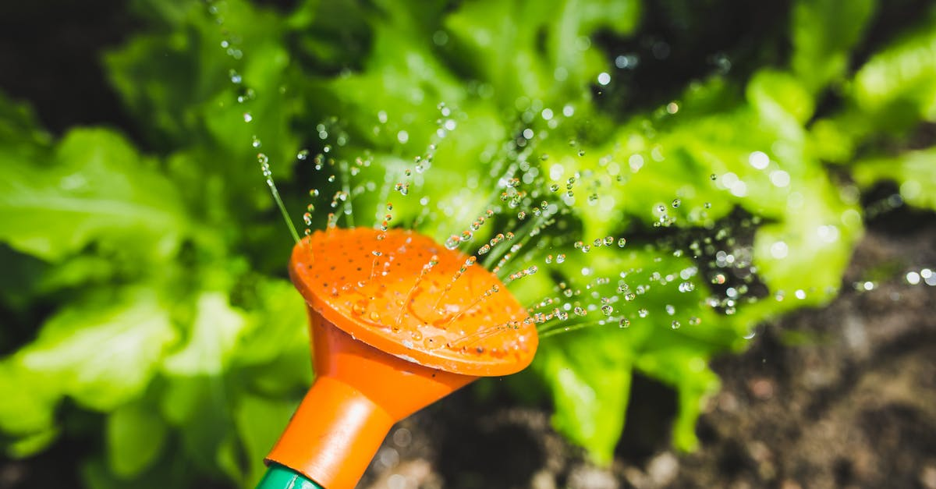
Watering
Water deep and infrequently
  1 to 2 inches a week
  Build root growth in soil
Watch raised beds and containers & water them more frequently
Water in early morning or evening
  Never water in full sunlight
Water on the ground level not overhead

Slide 7
Vegetables
Harvest cool season crops before hot weather hits
  Lettuce, radish, broccoli, spinach, peas
Identify ideal spots in the garden for shade and full sun
  Plant garden species accordingly
Fertilize at key stages of production
  Planting & beginning of production
Prevent weed growth

Slide 8
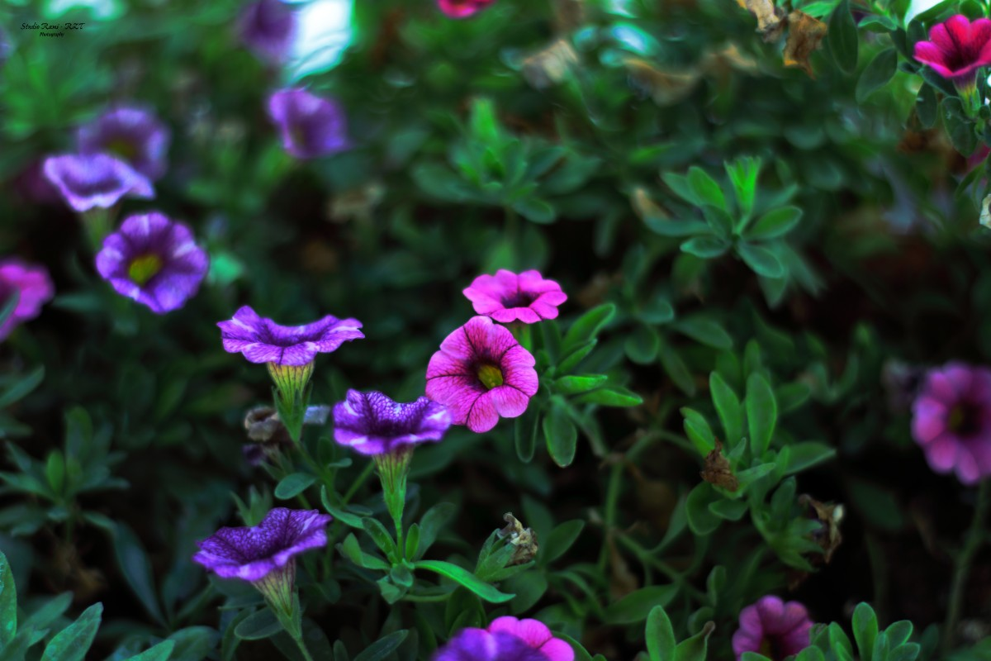
Annual Flowers
Keep up deadheading
  Geraniums, marigolds, salvia, snapdragons
Pinch back to remove tips and promote branching of stems when plants begin to get leggy

Slide 9
Perennial Flowers
Select for plants that can adapt to hot dry weather
Site location is key when your laying out your flowerbeds
Consider incorporating more ground cover plants
  Covers soil to prevent erosion
  Shares soil to prevent weeds
  Competes with other invasive plants by occupying root space
  Adds filler and beauty to landscape
  Choose carefully so they do not take over the bed

Slide 10
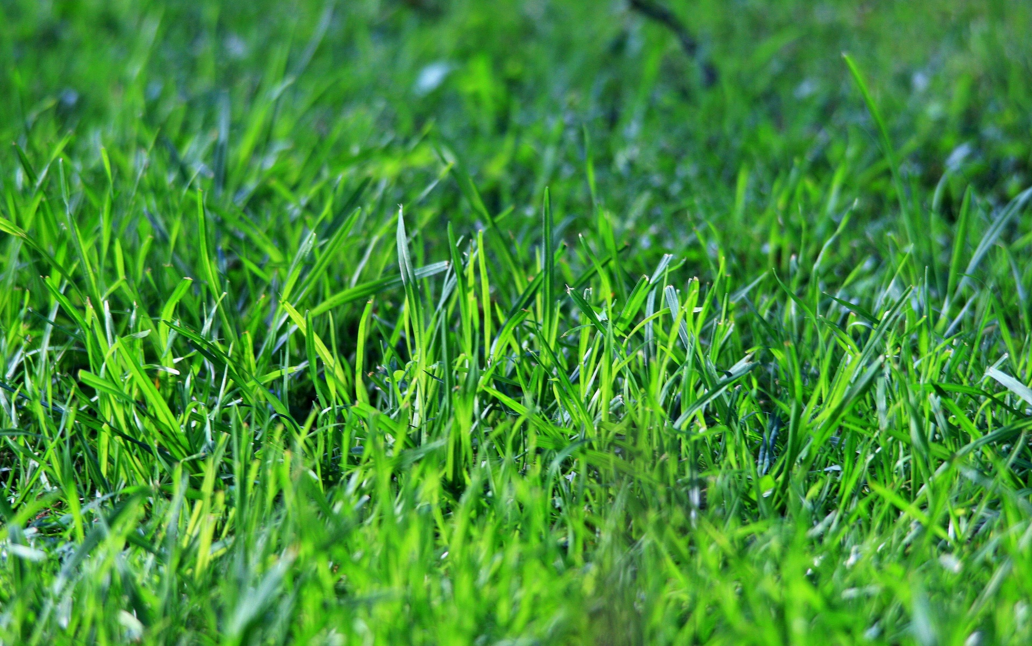
Lawns
Two Options
  Allow grass to go dormant
  Water to allow growth
    Water only when needed
Leave grass clippings for mulch
Mow higher to improve shade
Fall is the best time to fertilize (only when grass is actively growing)

Slide 11
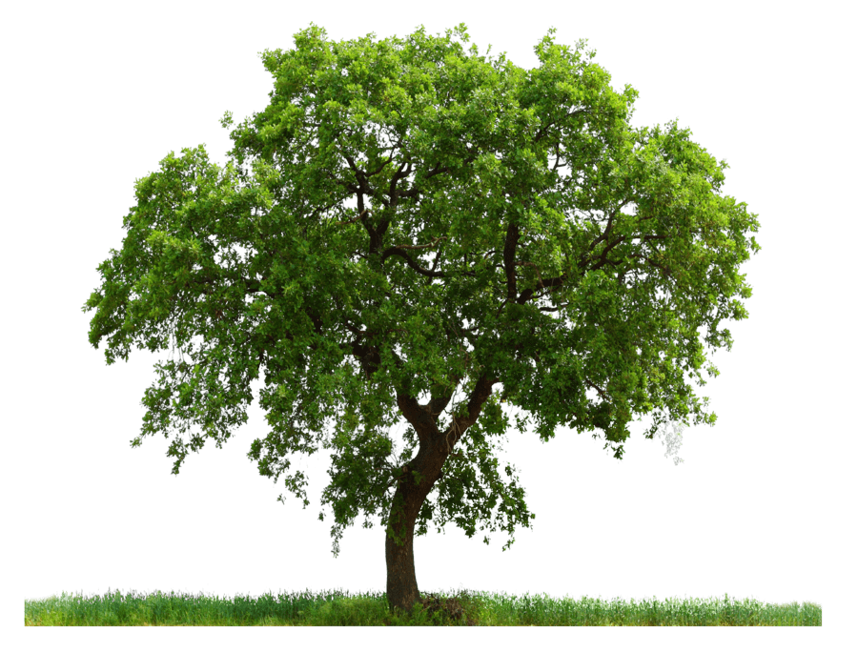
Trees
Typically, established trees need very little care during hot summer days
Young trees may need deep watering to help become established
Make sure you are preparing trees for winter
Mulching = 3x3x3 rule
Check trunk of tree on an annual basis

